Slide 1

HS2061 Information Systems Project Management
Sessions 1 & 2 – Tutor Dr. Farshid Keivanian
Tutorial Sessions 1 & 2 and Preparation for Individual Presentation
Step-by-Step Instructions for Individual Presentation:
Step 1: Review the Assignment Instructions
Download the documents attached to the 'Individual Presentation' section in Blackboard. These include the 'Individual Assignment Cover Sheet 2024' and 'HS2061 - Individual Presentation - T2 2024.pdf.'
Carefully read through these documents to understand the requirements, including presentation format, submission guidelines, and assessment criteria.
08

Slide 2
HS2061 Information Systems Project Management
Sessions 1 & 2 – Tutor Dr. Farshid Keivanian
Tutorial Sessions 1 & 2 and Preparation for Individual Presentation
Step 2: Choose Your Presentation Topic
Select a topic related to Project Management from the weekly materials presented between Sessions 5 and 11.
Topics include, but are not limited to, Project Scope Management, Project Time Management, Project Cost Management, Project Risk Management, and more.
08

Slide 3
HS2061 Information Systems Project Management
Sessions 1 & 2 – Tutor Dr. Farshid Keivanian
Tutorial Sessions 1 & 2 and Preparation for Individual Presentation
The PowerPoint Presentation format must contain:
1. Title slide – Topic and Student Details
2. Outline & Introduction
2.1 Introduction to the topic, important definitions, and presentation contents.
3. Presentation Body
3.1 Discussion on the topic selected.
3.2 Analysis using 2 Academic Journal Articles on the topic selected.
4. Conclusion
5. References - Adapted Harvard style
08

Slide 4
HS2061 Information Systems Project Management
Sessions 1 & 2 – Tutor Dr. Farshid Keivanian
Tutorial Sessions 1 & 2 and Preparation for Individual Presentation
Adapted Harvard Referencing Rules
Holmes has implemented a revised Harvard approach to referencing. The following rules apply:
Reference sources in assignments are limited to sources that provide full-text access to the
source’s content for lecturers and markers.
The reference list must be located on a separate page at the end of the essay and titled:
08

Slide 5
HS2061 Information Systems Project Management
Sessions 1 & 2 – Tutor Dr. Farshid Keivanian
“References”.
The reference list must include the details of all the in-text citations, arranged A-Z alphabetically by author surname with each reference numbered (1 to 10, etc.) and each reference MUST include a hyperlink to the full text of the cited reference source. For example:
Hawking, P., McCarthy, B. & Stein, A. 2004. Second Wave ERP Education, Journal of Information Systems Education, Fall, http://jise.org/Volume15/n3/JISEv15n3p327.pdf
All assignments must include in-text citations to the listed references. These must include the surname of the author/s or name of the authoring body, year of publication, page number of the content, and paragraph where the content can be found. For example, “The company decided to implement an enterprise-wide data warehouse business intelligence strategies (Hawking et al., 2004, p3(4)).”
08

Slide 6
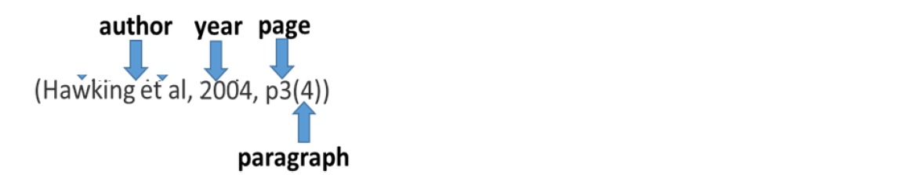
HS2061 Information Systems Project Management
Sessions 1 & 2 – Tutor Dr. Farshid Keivanian
Non-Adherence to Referencing Rules
Where students do not follow the above rules:
1. For students who submit assignments that do not comply with the rules, a 10% penalty will be applied.
2. As per the Student Handbook, late penalties will apply each day after the student/s has been notified of the due date.
3. Students who comply with rules and the citations are “fake” may be reported for academic misconduct.
08

Slide 7
HS2061 Information Systems Project Management
Sessions 1 & 2 – Tutor Dr. Farshid Keivanian
Tutorial Sessions 1 & 2 and Preparation for Individual Presentation
Step 3: Prepare Your Presentation
Develop a 10-minute presentation on your chosen topic. This should include:
Title Slide: Indicate the topic and your student details.
Outline & Introduction: Introduce the topic, provide important definitions, and outline the contents of your presentation.
Presentation Body: Discuss the topic, including analysis using at least two academic journal articles.
Conclusion: Summarize key points and findings.
References: Use Holmes Institute Adapted Harvard Referencing style.
08

Slide 8
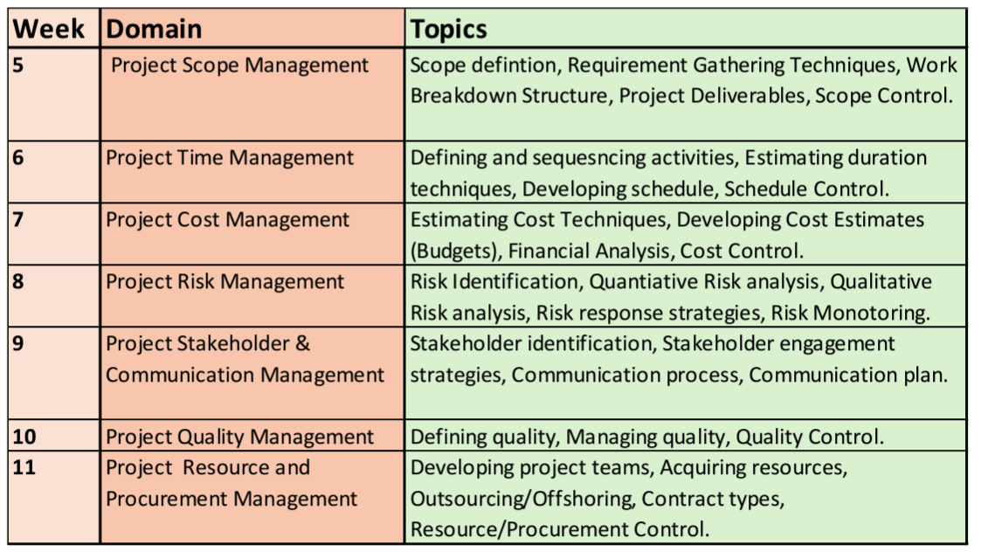
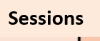
HS2061 Information Systems Project Management
Sessions 1 & 2 – Tutor Dr. Farshid Keivanian
Tutorial Sessions 1 & 2 and Preparation for Individual Presentation
08

Slide 9
HS2061 Information Systems Project Management
Sessions 1 & 2 – Tutor Dr. Farshid Keivanian
Tutorial Sessions 1 & 2 and Preparation for Individual Presentation
Step 4: Submit Your Presentation
Your presentation (in PowerPoint format) must be submitted to the Blackboard submission link by 9:00 AM each Monday before your scheduled tutorial.
If your presentation includes a video, upload the video to YouTube and submit the hyperlink along with your cover sheet.
08

Slide 10
HS2061 Information Systems Project Management
Sessions 1 & 2 – Tutor Dr. Farshid Keivanian
Tutorial Sessions 1 & 2 and Preparation for Individual Presentation
Step 5: Deliver Your Presentation
Present your topic during your allocated tutorial session between Session 5 and Sessions 1 & 21.
You will have 10 minutes for the presentation, followed by a 5-minute Q&A session.
08

Slide 11
HS2061 Information Systems Project Management
Sessions 1 & 2 – Tutor Dr. Farshid Keivanian
Tutorial Sessions 1 & 2 and Preparation for Individual Presentation
Important Notes:
Ensure your presentation is well-organized, clear, and visually appealing.
Be prepared to facilitate a discussion, engage with your peers, and answer questions.
Do not upload your presentation via mobile devices or tablets; use a desktop or laptop computer.
Late submissions are subject to penalties, and presentations delivered without prior submission will not receive full marks. (Marking penalty of -5% late submission per day)
08

Slide 12
HS2061 Information Systems Project Management
Sessions 1 & 2 – Tutor Dr. Farshid Keivanian
Tutorial Sessions 1 & 2 and Preparation for Individual Presentation
What Is Not Accepted:
Handwritten submissions, photos, screenshots, and any other format not specified in the instructions.
Emailed submissions or submissions for a different assessment or unit.
Files without a name and/or Student ID or with incorrect information.
08

Slide 13
HS2061 Information Systems Project Management
Sessions 1 & 2 – Tutor Dr. Farshid Keivanian
Tutorial Sessions 1 & 2 and Preparation for Individual Presentation
Marking Criteria:
Quality of Submitted Materials (5 Marks)
Facilitated Discussion (5 Marks)
Fluency & Voice (5 Marks)
Interaction with Tutorial Attendees (5 Marks)
08

Slide 14
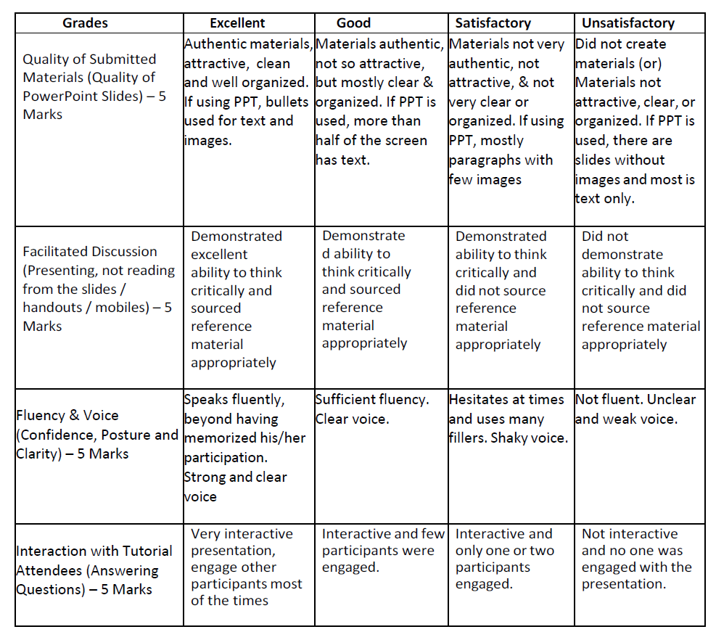
HS2061 Information Systems Project Management
Sessions 1 & 2 – Tutor Dr. Farshid Keivanian
Rubric Criteria
08

Slide 15
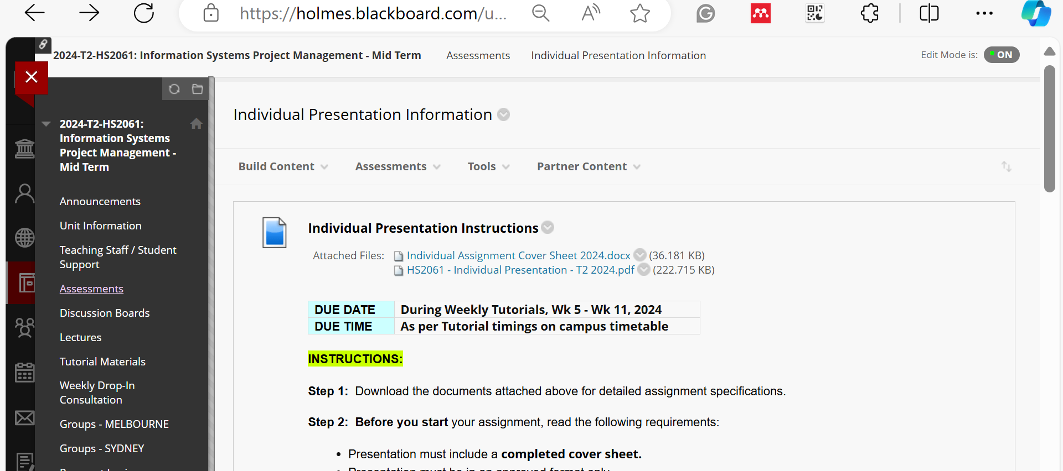
HS2061 Information Systems Project Management
Sessions 1 & 2 – Tutor Dr. Farshid Keivanian
Tutorial Sessions 1 & 2 and Preparation for Individual Presentation
08

Slide 16
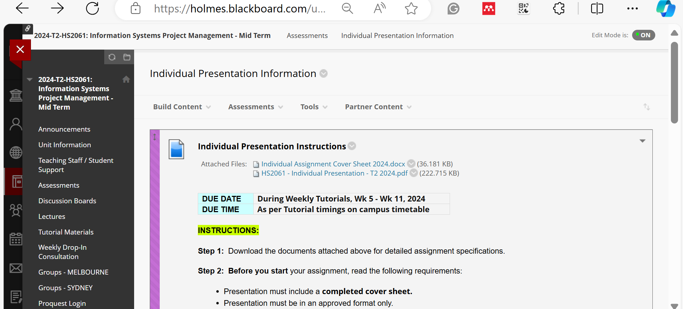
HS2061 Information Systems Project Management
Sessions 1 & 2 – Tutor Dr. Farshid Keivanian
Tutorial Sessions 1 & 2 and Preparation for Individual Presentation
08

Slide 17
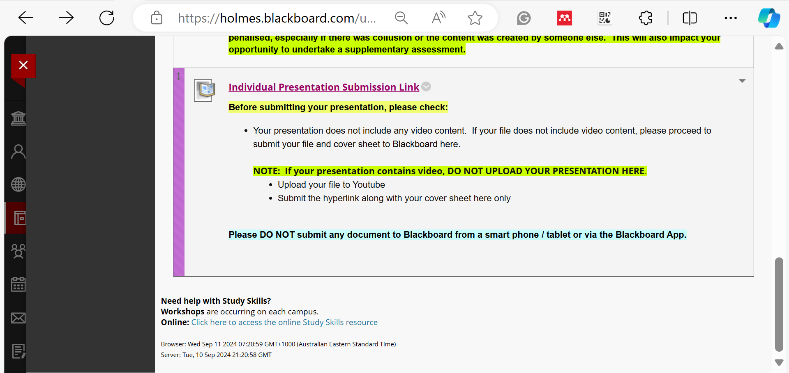
HS2061 Information Systems Project Management
Sessions 1 & 2 – Tutor Dr. Farshid Keivanian
Tutorial Sessions 1 & 2 and Preparation for Individual Presentation
08

Slide 18
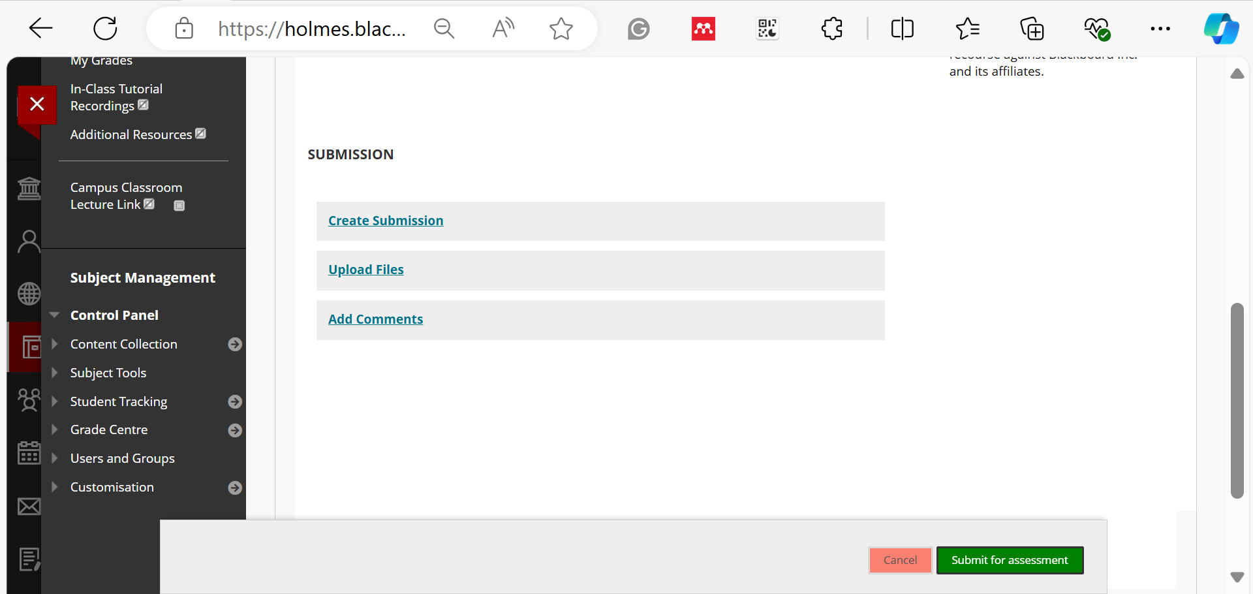
HS2061 Information Systems Project Management
Sessions 1 & 2 – Tutor Dr. Farshid Keivanian
Tutorial Sessions 1 & 2 and Preparation for Individual Presentation
08

Slide 19
HS2061 Information Systems Project Management
Sessions 1 & 2 – Tutor Dr. Farshid Keivanian
Tutorial Sessions 1 & 2 and Preparation for Individual Presentation
By following these steps, you will be well-prepared to complete your Individual Presentation successfully. Good luck!
08

Slide 20
HS2061 Information Systems Project Management
Sessions 1 & 2 – Tutor Dr. Farshid Keivanian
Introduction to Project Scope Management
08

Slide 21
HS2061 Information Systems Project Management
Sessions 1 & 2 – Tutor Dr. Farshid Keivanian
Introduction to Project Scope Management
Introduction: In this session, we will dive into Project Scope Management, a critical domain in project management that ensures all the work required—and only the work required—to complete a project successfully is included. The topics we'll cover include scope definition, requirement gathering techniques, work breakdown structure (WBS), project deliverables, and scope control. These concepts are fundamental in ensuring that your project stays on track and meets its objectives without scope creep or unnecessary delays.
08

Slide 22
HS2061 Information Systems Project Management
Sessions 1 & 2 – Tutor Dr. Farshid Keivanian
Introduction to Project Scope Management
Scenario Presentation: Imagine you are working for a tech company like Atlassian, tasked with developing a new project management tool. One of your first responsibilities is to define the project scope clearly. If the scope is not well-defined, the project could expand beyond its original goals, leading to delays and increased costs. Your team needs to gather requirements effectively, break down the project work into manageable parts, and control the scope throughout the project lifecycle to ensure success.
08

Slide 23
HS2061 Information Systems Project Management
Sessions 1 & 2 – Tutor Dr. Farshid Keivanian
Introduction to Project Scope Management
Class Discussion Question: What do you think could happen if a project's scope is not clearly defined at the beginning? How might this impact the project's timeline, budget, and quality?
08

Slide 24
HS2061 Information Systems Project Management
Sessions 1 & 2 – Tutor Dr. Farshid Keivanian
Introduction to Project Scope Management
Responses:
"The project could face delays because of unclear or changing requirements."
"The budget might increase as more work is added without proper justification."
"The quality of the final product could suffer due to a lack of focus on the core objectives."
08

Slide 25
HS2061 Information Systems Project Management
Sessions 1 & 2 – Tutor Dr. Farshid Keivanian
Introduction to Project Scope Management
Multiple-Choice Question: What is the primary goal of Project Scope Management?
To ensure all work required for the project is completed.
To monitor the project's budget.
To control the project's schedule.
To manage the project team.
08

Slide 26
HS2061 Information Systems Project Management
Sessions 1 & 2 – Tutor Dr. Farshid Keivanian
Introduction to Project Scope Management
Summary Sentence: Project Scope Management is essential for defining, documenting, and controlling what is and is not included in a project, preventing scope creep and ensuring project success.
08

Slide 27
HS2061 Information Systems Project Management
Sessions 1 & 2 – Tutor Dr. Farshid Keivanian
Scope Definition
Introduction: Scope definition involves outlining the project's boundaries and deliverables, which serve as the foundation for all project planning. This step ensures that everyone involved understands the project's objectives and what needs to be accomplished.
08

Slide 28
HS2061 Information Systems Project Management
Sessions 1 & 2 – Tutor Dr. Farshid Keivanian
Scope Definition
Scenario Presentation: Consider you are working on a software development project for a healthcare organization like Medibank. You need to define the scope of a new patient management system. This includes specifying all the features that the system will have, such as patient records, appointment scheduling, and billing, as well as the features it will not include. Clear scope definition will help avoid confusion and ensure the project meets the organization's needs.
08

Slide 29
HS2061 Information Systems Project Management
Sessions 1 & 2 – Tutor Dr. Farshid Keivanian
Scope Definition
Class Discussion Question: Why is it important to define both what is included and what is excluded from the project scope? How can this clarity help the project team?
08

Slide 30
HS2061 Information Systems Project Management
Sessions 1 & 2 – Tutor Dr. Farshid Keivanian
Scope Definition
Responses:
"It helps prevent scope creep by clearly outlining the project's boundaries."
"It ensures that the project team and stakeholders have a shared understanding of the project's goals."
"It helps in managing expectations and reduces the risk of conflicts later on."
08

Slide 31
HS2061 Information Systems Project Management
Sessions 1 & 2 – Tutor Dr. Farshid Keivanian
Scope Definition
Multiple-Choice Question: Which of the following is not a component of scope definition?
Project objectives
Project boundaries
Project stakeholders
Project deliverables
08

Slide 32
HS2061 Information Systems Project Management
Sessions 1 & 2 – Tutor Dr. Farshid Keivanian
Scope Definition
Summary Sentence: Scope definition is crucial for setting clear boundaries and expectations for a project, which helps prevent scope creep and keeps the project focused on its goals.
08

Slide 33
HS2061 Information Systems Project Management
Sessions 1 & 2 – Tutor Dr. Farshid Keivanian
Requirement Gathering Techniques
Introduction: Requirement gathering is a key process in project management where the needs and expectations of stakeholders are identified and documented. This step ensures that the project team understands what the stakeholders expect the project to deliver.
08

Slide 34
HS2061 Information Systems Project Management
Sessions 1 & 2 – Tutor Dr. Farshid Keivanian
Requirement Gathering Techniques
Scenario Presentation: Imagine you are managing a project for a retail company like Woolworths, developing an e-commerce platform. You need to gather requirements from various stakeholders, including customers, sales teams, and IT staff. Techniques like interviews, surveys, and focus groups will be critical in understanding their needs and translating them into project requirements.
08

Slide 35
HS2061 Information Systems Project Management
Sessions 1 & 2 – Tutor Dr. Farshid Keivanian
Requirement Gathering Techniques
Class Discussion Question: What are some challenges you might face during requirement gathering, and how could you overcome them?
Responses:
"Stakeholders might have conflicting requirements, which can be managed by prioritizing the most critical needs."
"Some stakeholders might not be able to articulate their needs clearly, requiring additional probing and clarification."
"Requirements might change over time, so it's important to have a process in place for managing changes."
08

Slide 36
HS2061 Information Systems Project Management
Sessions 1 & 2 – Tutor Dr. Farshid Keivanian
Requirement Gathering Techniques
Multiple-Choice Question: Which of the following is a common technique used for gathering project requirements?
Budget analysis
Focus groups
Resource allocation
Risk assessment
08

Slide 37
HS2061 Information Systems Project Management
Sessions 1 & 2 – Tutor Dr. Farshid Keivanian
Requirement Gathering Techniques
Summary Sentence: Effective requirement gathering ensures that a project's outcomes meet stakeholder expectations and lays the groundwork for successful project execution.
08

Slide 38
HS2061 Information Systems Project Management
Sessions 1 & 2 – Tutor Dr. Farshid Keivanian
Work Breakdown Structure (WBS)
Introduction: The Work Breakdown Structure (WBS) is a hierarchical decomposition of the total scope of work to accomplish the project objectives and create the deliverables. It provides a structured vision of what has to be delivered.
08

Slide 39
HS2061 Information Systems Project Management
Sessions 1 & 2 – Tutor Dr. Farshid Keivanian
Work Breakdown Structure (WBS)
Scenario Presentation: Let's say you're part of a project team at Google working on a new product launch. To manage this complex project, you create a WBS that breaks down the project into manageable tasks, such as market research, product design, testing, and marketing. Each of these tasks is further divided into subtasks, ensuring that every aspect of the project is planned and monitored effectively.
08

Slide 40
HS2061 Information Systems Project Management
Sessions 1 & 2 – Tutor Dr. Farshid Keivanian
Work Breakdown Structure (WBS)
Class Discussion Question: How can creating a WBS help in managing a large and complex project? What are the benefits of breaking down the work into smaller components?
Responses:
"It makes it easier to assign tasks and track progress."
"It helps in identifying the resources needed for each task."
"It reduces the risk of missing important steps in the project."
08

Slide 41
HS2061 Information Systems Project Management
Sessions 1 & 2 – Tutor Dr. Farshid Keivanian
Work Breakdown Structure (WBS)
Multiple-Choice Question: What is the primary purpose of a Work Breakdown Structure (WBS)? a) To allocate resources for the project
b) To define the project schedule
c) To break down the project scope into manageable tasks
d) To monitor the project budget
08

Slide 42
HS2061 Information Systems Project Management
Sessions 1 & 2 – Tutor Dr. Farshid Keivanian
Work Breakdown Structure (WBS)
Summary Sentence: A Work Breakdown Structure (WBS) organizes the project scope into manageable tasks, facilitating better planning, execution, and monitoring.
08

Slide 43
HS2061 Information Systems Project Management
Sessions 1 & 2 – Tutor Dr. Farshid Keivanian
Project Deliverables
Introduction: Project deliverables are the tangible or intangible outcomes that are produced as a result of project execution. They are the building blocks that lead to the project's final product, service, or result.
08

Slide 44
HS2061 Information Systems Project Management
Sessions 1 & 2 – Tutor Dr. Farshid Keivanian
Project Deliverables
Scenario Presentation: Consider a project at Tesla where the goal is to develop a new electric vehicle model. The deliverables would include the car prototype, battery system, software for autonomous driving, and marketing materials. Each deliverable contributes to the overall success of the project.
08

Slide 45
HS2061 Information Systems Project Management
Sessions 1 & 2 – Tutor Dr. Farshid Keivanian
Project Deliverables
Class Discussion Question: Why is it important to clearly define project deliverables, and how can unclear deliverables affect the project outcome?
Responses:
"Clear deliverables ensure that everyone knows what needs to be produced."
"Unclear deliverables can lead to confusion, rework, and delays."
"They provide a basis for measuring project progress and success."
08

Slide 46
HS2061 Information Systems Project Management
Sessions 1 & 2 – Tutor Dr. Farshid Keivanian
Project Deliverables
Multiple-Choice Question: Which of the following is considered a project deliverable?
Project budget
Risk assessment plan
Project schedule
Product prototype
08

Slide 47
HS2061 Information Systems Project Management
Sessions 1 & 2 – Tutor Dr. Farshid Keivanian
Project Deliverables
Summary Sentence: Defining clear project deliverables is essential for ensuring that the project produces the required outcomes, which are key to its success.
08

Slide 48
HS2061 Information Systems Project Management
Sessions 1 & 2 – Tutor Dr. Farshid Keivanian
Scope Control
Introduction: Scope control involves monitoring the status of the project and managing changes to the scope baseline. It ensures that any changes to the project scope are properly documented, evaluated, and approved.
08

Slide 49
HS2061 Information Systems Project Management
Sessions 1 & 2 – Tutor Dr. Farshid Keivanian
Scope Control
Scenario Presentation: Imagine you are managing a project for Microsoft, where the scope was initially defined to develop a new software application. Midway through the project, a stakeholder requests additional features. Through scope control, you assess the impact of these changes on the project's timeline and budget and decide whether to accept, defer, or reject the change request.
08

Slide 50
HS2061 Information Systems Project Management
Sessions 1 & 2 – Tutor Dr. Farshid Keivanian
Scope Control
Class Discussion Question: How can effective scope control prevent scope creep, and what strategies can you use to manage changes to the project scope?
Responses:
"Effective scope control helps ensure that only necessary changes are made, preventing scope creep."
"Strategies include having a formal change management process, involving stakeholders in scope decisions, and regularly reviewing project scope against the original plan."
08

Slide 51
HS2061 Information Systems Project Management
Sessions 1 & 2 – Tutor Dr. Farshid Keivanian
Scope Control
Multiple-Choice Question: Which of the following is a key activity in scope control?
Resource allocation
Change request management
Budget forecasting
Team management
08

Slide 52
HS2061 Information Systems Project Management
Sessions 1 & 2 – Tutor Dr. Farshid Keivanian
Scope Control
Summary Sentence: Scope control is critical for managing changes to the project scope, preventing scope creep, and ensuring the project stays on track.
08

Slide 53
HS2061 Information Systems Project Management
Sessions 1 & 2 – Tutor Dr. Farshid Keivanian
Final Summary
Project Scope Management ensures that all the necessary work for a project is included and managed effectively. By defining the scope, gathering requirements, creating a WBS, managing deliverables, and controlling scope changes, you can lead projects to successful completion without unnecessary delays or budget overruns.
08

Slide 54
Happy A Learning Day!
Lecturer/Tutor: Dr. Farshid Keivanian

